Slide 1
What is blockchain?
A brief prelude to cryptocurrencies
Domagoj Vrgoč

Slide 2
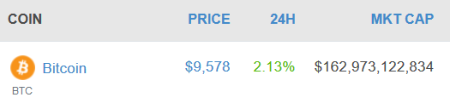
What do kids talk about these days?
Bitcoin/blockchain is all the rage on the net:
Already mainstream (your parents are asking should they buy bitcoin)
Blockchain proposed for everything these days
For insta gains of market value sell yourself as a "blockchain company"
Main reason: money

Slide 3
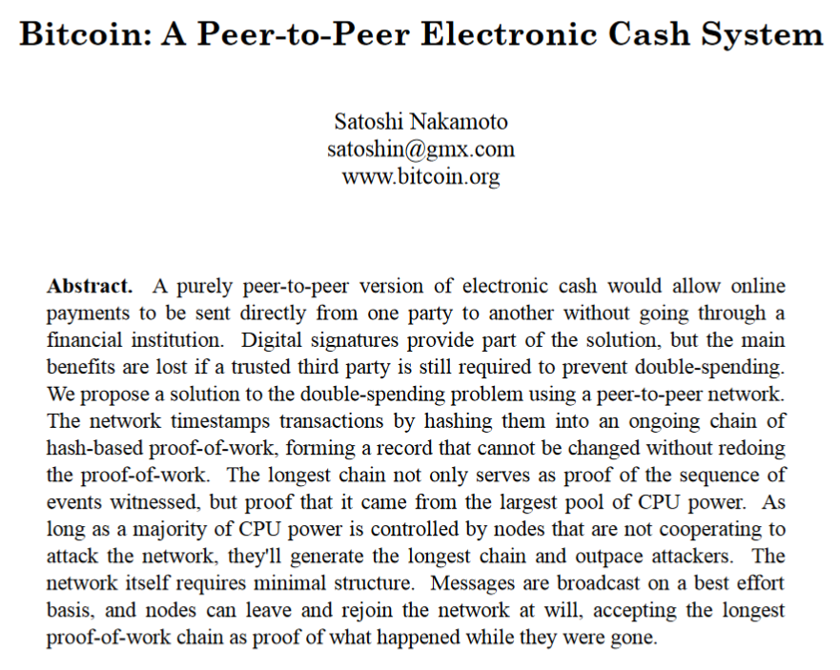
Where does this come from?

Slide 4
What makes bitcoin work?
Blockchain
Decentralized concensus

Slide 5
Blockchain
Publishing data in a transparent way:
Append only ledger
No modifications of published data are possible
To assure this I only need to store a few bits of information
Even for terabytes of data
Not the same as Bitcoin; can be centralized

Slide 6
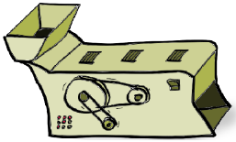
Blockchain
One technical ingredient: cryptographic hash functions

Slide 7

Blockchain
One technical ingredient: cryptographic hash functions
Arbitrary size

Slide 8

Blockchain
One technical ingredient: cryptographic hash functions
Arbitrary size
Fixed size

Slide 9
Blockchain
One technical ingredient: cryptographic hash functions
Output gives no information about the input
Arbitrary size
Fixed size

Slide 10
Blockchain
One technical ingredient: cryptographic hash functions
Output gives no information about the input
SHA - 256
Arbitrary size
Fixed size

Slide 11

How DO hash functions work?

Slide 12
How DO hash functions work?
43115F48F39C0120C5D4D
3435DFD5CD933734963D4
75364A9C232B71DB601EE4

Slide 13
How DO hash functions work?
43115F48F39C0120C5D4D
3435DFD5CD933734963D4
75364A9C232B71DB601EE4

Slide 14
How DO hash functions work?
43115F48F39C0120C5D4D
3435DFD5CD933734963D4
75364A9C232B71DB601EE4

Slide 15
How DO hash functions work?
Bitcoin

Slide 16
How DO hash functions work?
Bitcoin
B4056DF6691F8DC72E56302DDAD345D65FEAD3EAD9299609A826E2344EB63AA4

Slide 17
How DO hash functions work?
Bitcoin
B4056DF6691F8DC72E56302DDAD345D65FEAD3EAD9299609A826E2344EB63AA4
bitcoin

Slide 18
How DO hash functions work?
Bitcoin
B4056DF6691F8DC72E56302DDAD345D65FEAD3EAD9299609A826E2344EB63AA4
bitcoin
6B88C087247AA2F07EE1C
5956B8E1A9F4C7F892A70
E324F1BB3D161E05CA107B

Slide 19
What's the Point?
To verify that the data did not change, only the hash is needed
H(data)
data

Slide 20
What's the Point?
H(data)
data
H(data)

Slide 21

What's the Point?
H(data)
data'

Slide 22
What's the Point?
H(data)
data'
H(data)

Slide 23
What's the Point?
H(data)
data'
H(data')
H(data)

Slide 24
What's the Point?
H(data)
data'
H(data')
≠
H(data)

Slide 25

What's the Point?
H(data)
data'
H(data')
≠
H(data)

Slide 26
blockchain
data 1
data 1
data 2
data 3
Block 1
data 2
data 3
Block 1
Block 2

Slide 27
blockchain
data 1
data 1
data 2
data 3
Block 1
data 2
data 3
Block 1
Block 3

Slide 28
blockchain
H(Block1)
data 1
data 1
data 2
data 3
Block 1
data 2
data 3
Block 1
Block 2
Block 3

Slide 29
blockchain
H(Block1)
data 1
data 1
data 2
data 3
Block 1
data 2
data 3
Block 1
Block 2
Block 3
H(Block3)

Slide 30
blockchain
H(Block1)
data 1
data 1
data 2
data 3
Block 1
data 2
data 3
Block 1
Block 2
Block 3
H(Block3)

Slide 31
blockchain
H(Block1)
H(Block2)
data 1
data 1
data 2
data 3
Block 1
data 2
data 3
Block 1
Block 2
Block 3
H(Block3)

Slide 32
blockchain
H(Block1)
H(Block2)
data 1
data 1
data 2
data 3
Block 1
data 2
data 3
Block 1
Block 2
Block 3

Slide 33
blockchain
H(Block1)
H(Block2)
data 1
data 1
data 2
data 3
Block 1
data 2
data 3
Block 1
Block 2
Block 3

Slide 34
blockchain
H(Block1)
H(Block2)
data 1
data 1
data 2
data 3
Block 1
data 2
data 3
Block 1
Block 2
Block 3
H(Block3)
If we store H(Block3), no data before it can be modified

Slide 35
blockchain
H(Block1)
H(Block2)
data 1
data 1
data 2
data 3
Block 1
data 2
data 3
Block 1
Block 2
Block 3
H(Block3)
If we store H(Block3), no data before it can be modified

Slide 36


Blockchain use case: open data
"Data to the people"

Slide 37

Blockchain use case: open data
"Data to the people"
Are you cheating?

Slide 38
Blockchain use case: open data
Government data can be transparent and immutable
Just publish it in a blockchain
Anyone with a hash can check that the data did not change
Also works for completely secret data (hash of the hash)
Good way to go about it:
A consortium of non profit agencies monitoring government data
Government publishes the data in a blockchain manner
Periodically (weekly/monthly) the final header is saved
Ongoing work at the Institute for Foundational Research on Data

Slide 39





Work done AT UC
DataLab DCC/Institute for Foundational Research on Data

Slide 40
What are we doing at DataLab?
When should I cheat in Bitcoin mining?
Should the protocol be changed?
Is the Bitcoin's network as Satoshi intended?
Blockchain based tools for public/government data

Slide 41

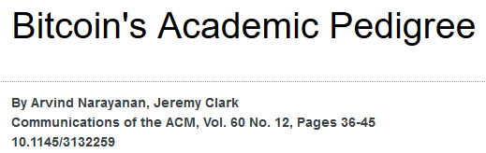
Where to learn more?

Slide 42
Thank you!

Slide 43
Back to cryptocurrencies

Slide 44
Simple cryptocurrencies
Blockchain can be used to record financial transactions
We can check where the money comes from
We can check it was not spent twice
No forgery is possible
But someone has to check this and publish the blocks:
Government/bank does this, but does not publish your data
This scheme is known as Scrooge-coin:
Actually used in practice (Ripple ~ 34 Billion USD)
Precursor to this (without the blockchain): paypal

Slide 45
Decentralization
Issues with having a central party maintaining the blockchain:
Allows manipulating access, value, validity
Can blacklist people (free market does not allow this)
Single point of failure
Do we really need this?

Slide 46
Bitcoin's decentralization model
Main ideas:
A peer-to-peer network maintains the blockchain
One node puts the next block in the chain
Who puts the block:
Nodes compete to solve a computational puzzle (mining)
The winner gets newly created bitcoins (how bitcoins are created)

Slide 47
Bitcoin's decentralization model
Why does this work?
There is money involved
Solving the puzzle requires a lot of electricity (costs money)
If the miner includes "wrong" transactions in the block:
She loses her money (block reward)
Because the rest of the network will catch on this and reject the block

Slide 48
Bitcoin
Pros:
Decentralized
Secure (no forgery possible)
Fast
Cons:
Slow: VISA has an order of magnitude more throughput
An ecological catastrophe? (mining wastes electricity)
Irreversible transaction

Slide 49
Cryptocurrencies with other uses
Ripple: a service for sending money (cheaper than SWIFT)
Monero: complete anonymity (financial democracy tool)
Ethereum/EOS:
Computation is done by the network
This is the future

